Slide 2
Building Serverless Cloud Applications with Azure Functions
Speaker name
Notes:
Mention that this talk is a followup to yesterday’s session on serverless in general: we will overlap a little but its not necessary to have gone to the previous talk

Slide 3



Azure Functions
Azure Functions
Code
Events + data
Process events with Serverless code.
BAM!!!
Make composing Cloud Apps insanely easy
Develop Functions in C#, Node.js, F#, and more
Easily manage event-driven tasks across services
Expose Functions as HTTP API endpoints
Scale Functions based on customer demand
Easily integrate with other services
Notes:
“What is Azure Functions?”

Slide 4
Language Support
Languages | Status | Notes
C# | GA | C# Script and Class Libraries
JavaScript | GA | Node, 6.5.0 and 8.4.0
F# | GA | F# Script and Class Libraries
Java | Preview | Maven, Jenkins, Eclipse, VS Code Supported
Additional Experimental Languages: Python, Bash, Powershell, Batch, PHP, TypeScript
Notes:
Per previous slide, you can write Functions in many languages, with more on the way!
All experimental means is that its meant for POCs rather than production workloads in its current state.

Slide 5
Demo
Hello World
Notes:
Script:
Bump out to portal/login
Create new Fx App
Create new HTTP Fx (maybe poll audience for C# vs JS)
Walk through hello world code
Copy endpoint address, visit in browser, append “&name=“<City you’re in>”
Bump back to portal
Make change to code (maybe append “!!!!!!!!!!!!!!!!!”)
Go back to endpoint and see changes

Slide 6
Customer Success Stories

Slide 7
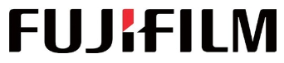
“We were able to move development along smoothly and cost-effectively, even when unexpected issues arose, by taking advantage of Azure capabilities”
JYuki Chiba
Design Leader,
Advanced Solutions Group
Transformed its popular IMAGE WORKS service through Azure serverless technologies.
Benefits:
Latency reduced by 95%
Development time reduced by 75%
Higher reliability
Ability to add new features and releases faster and more frequently
Notes:
We have many customers who have seen success with serverless technologies. Today we want to talk about a few of them:
First one is FUJIFILM.
They had a very popular image management/sharing service that handled more than a terabyte of data each day.
They were looking to improve the customer experience by providing better reliability and lower latency in the service
Another goal was to rearchitect their service in a way that allows them to add future enhancements more quickly and at a faster cadence
In the previous version of the service, they found that they were spending an inordinate amount of time in dealing with things that had nothing to do with the core business – things like managing the infrastructure, worrying about adding more servers when demand goes up, and so on.
When they moved to serverless architecture, they didn’t have to do any of that, and they saved 75% time on their development costs.
And when they started building the actual service, by the virtue of using Azure Functions, they could very naturally adopt a microservices architecture which decouples the development efforts of different teams and allows you to introduce enhancements to the system without disrupting the existing service. This improves the uptime of the service.
Also, by the virtue of using Cosmos DB, a fully managed, planet scale DB for their serverless app, they were able to reduce the overall latency by 95%, far exceeding the goals they had set for themselves.

Slide 8
The evolution of application platforms
On-Premises
IaaS
PaaS
Serverless
Notes:
“What is serverless?”

Slide 9
What is Serverless?
Abstraction of servers
Event-driven/ instant scale
Micro-billing
Notes:
Abstraction of servers, infrastructure and configuration of operating system
Event-driven scale
Sub-second billing
Stateless
Serverless compute is a fully managed service. Some refer to it as Functions as a Service
OS and Framework patching is performed for you
There is zero administrative tasks and no need to manage any infrastructure
You just deploy your code (function) and it runs
Your code runs within seconds and for very short period of time
Serverless compute scales quickly (almost instantly) and vastly
Automatically scales within seconds
No scale configuration is required (there is no way to configure scale or limits)
Scales to match any given workload. Scales from zero to handle tens of thousands concurrent functions invocations within seconds
Pay only for the time your code is running
Serverless compute reacts to events
React, in near real-time, to events and triggers
Triggered by virtually any event from Azure service or 3rd party services

Slide 10
Benefits of Serverless
Manage apps, not servers
Reduced DevOps
Faster time to market
Notes:
“Pinnacle of PaaS compute”
Not just hardware “servers”, but software servers are also managed for you
Focus on business logic, not solving technical problems not core to business
Lower effort to get started makes it easier to experiment (bots, etc.)
Benefits of “Serverless”

Slide 11





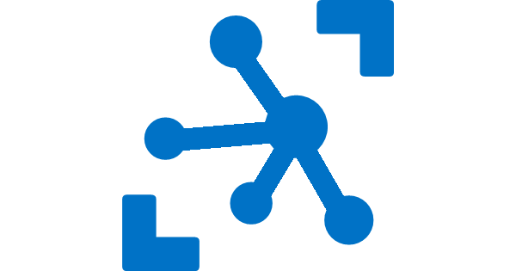


Serverless application platform components
Development
Platform
IDE support
Event Grid
Logic Apps
Functions
Manage all events that can trigger code or logic
Design workflows and orchestrate processes
Execute your code based on events you specify
Integrated DevOps
Local Development
Monitoring
Database
Storage
Security
IoT
Analytics
Intelligence
Visual Debug History
Notes:
Azure’s serverless picture

Slide 12



Ways to Run Functions
Consumption
Serverless
App Service Plan
Free, Basic, Standard, Premium
App Service Environment
Network Isolation
Azure Stack
On Premises
Azure Functions Runtime (preview)
Functions on your Server
Azure IoT Edge (preview)
On Devices
Pay only for what you use! Metering is per execution and per GB Second.
All the advantages of Functions with the SLA and ‘always on’ features of an App Service Plan.
Your own dedicated cloud environment with network isolation for apps, higher scale, and the ability to connect securely to local vNets.
Leverage cloud innovations in on-premises infrastructure. Azure Stack brings the power of Azure to your own data centers.
Run on IoT Devices by deploying custom modules.
Run your Azure Functions on your local server (without the rest of Azure)

Slide 13
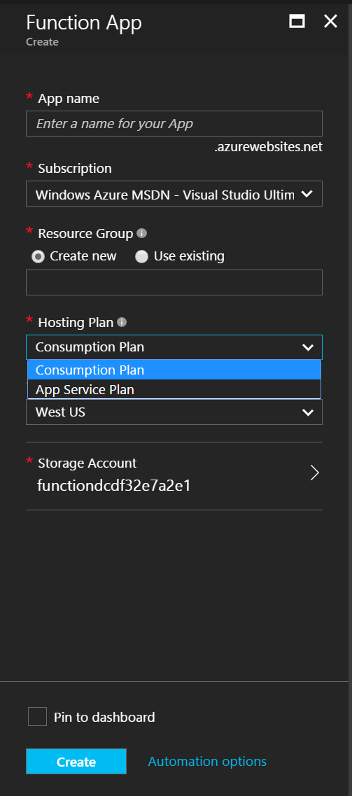
Consumption Plan
The Consumption Plan option
Pay for what you use without the need to reserve compute resources.
Function Apps are assigned to compute processing instances that are scaled dynamically by the platform.
Functions can have multiple parallel executions minimizing the total time needed to process requests.
Cost is driven by the number of executions and by accounting for memory size used and total execution time across all functions in a Function App as measured in gigabyte-seconds.
Selection guidance
Good option if your functions run at elastic scale with potentially intermittent executions.
Notes:
The Consumption Plan does not allow explicit scale configuration (including compute instance size or number of compute instances). The scale is managed entirely by the platform based on incoming events.

Slide 14
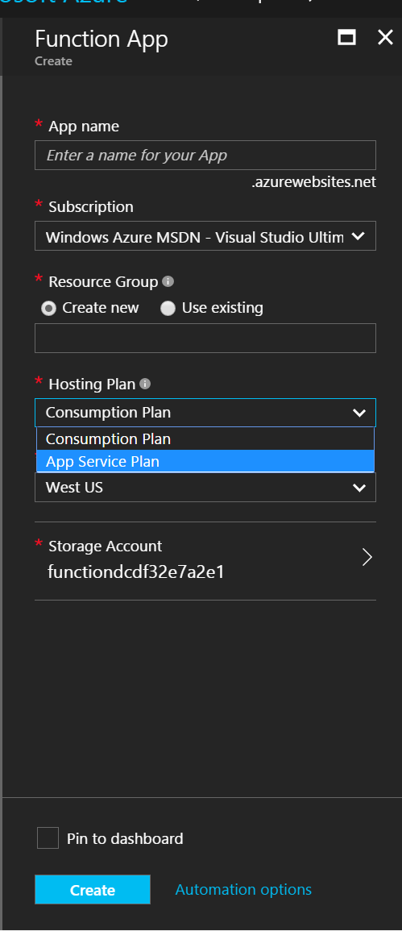
App Service Plan
The App Service Plan option
Function Apps run on dedicated VMs, just like Web Apps work today for Basic, Standard, or Premium SKUs.
Dedicated VMs are allocated to your apps and they are always available whether code is being actively executed or not.
Selection guidance
Good option if you have existing, under-utilized VMs that are already running other code
or
Good option if you expect to run functions continuously or almost continuously
Notes:
In some cases where functions run continuously this option may be more cost effective.

Slide 15
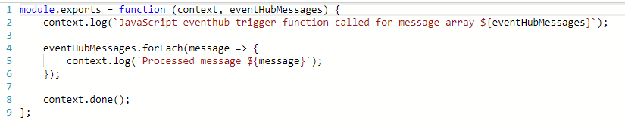
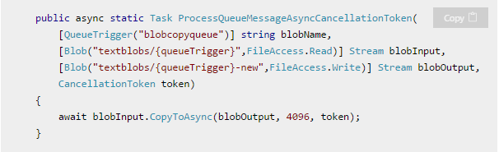
What is the “Functions” programming model?
Function as the unit of work
Functions are executed; they start and finish
Functions have triggers
Functions can have inputs and outputs (bindings)
Notes:
First, a simple event hub JS function (just trigger)
Then, a good example of a C# function with a trigger and input/output bindings

Slide 16
Building Serverless APIs

Slide 17



Deployment and management isolation
Customers
customers.azurewebsites.net
Products
products.azurewebsites.net
API calls
Orders
orders.azurewebsites.net
Notes:
Proxies allow you to easily set up an API

Slide 18
Function app B
/products
Function2
Function app A
/customers
Function1
/products
Function app C
/orders
/orders
Function3
Key:
HttpTrigger function endpoints
API proxy endpoints
Notes:
Redirection made easy

Slide 19
Tooling

Slide 20

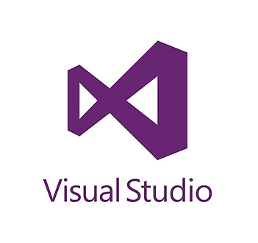
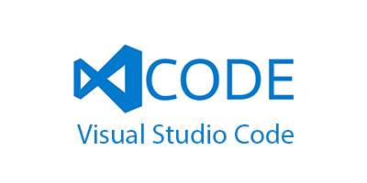
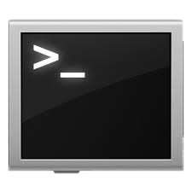
Azure Functions Tooling Options
Portal (with Kudu)
Visual Studio
VS Code
CLI

Slide 21
Development tools
Monitoring: App Insights
Local debugging: VS, VS Code
Run locally: X-Plat CLI
Publish: VSTS, Maven
CD: GitHub, BitBucket, Jenkins…
Inner loop
Outer loop
Notes:
Inner loop: a developers life day to day, writing and debugging code
Outer loop: a developers life week to week, pushing code and monitoring their service
We fulfill developer needs for both scenarios.

Slide 22
Demo
Coding with Azure Functions in Visual Studio
Notes:
Script:
1) Bump out to visual studio with

Slide 23
Monitoring
Monitor
What is my app doing?
Alert
Is my app unhealthy?
Diagnose
Why is it unhealthy?
Learn
What was my app doing?
Notes:
“Why is monitoring important”

Slide 24
Azure Application Insights
Extensible Application Performance Management (APM)
Rich data: Metrics, Traces, Exception tracking, Dependencies, Page Views, User data, custom events
Easy to use graph/alerts, powerful analytics portal, integration with PowerBI and other analytics services
Notes:
App Insights!
Mention Functions has two options for monitoring: in portal and App Insights, with App Insights being the premium service

Slide 25
Demo
Monitoring a Rapidly Scaling Function
Notes:
Script:
1) Bump out to portal

Slide 26
Demo
Photo Mosaic
Notes:
Setup:
Visit https://photomosaic-prod.azurewebsites.net/ for working demo
Pull https://github.com/Azure-Samples/functions-dotnet-photo-mosaic
Script:
1) Show code, no need to fully walk through at beginning since it’s a bit complicated
2) Visit link – upload photo and pick a search term (I personally like functions logo made out of random things)
3) Try a few more photos for fun. You can also test the original purpose of the app which involves detecting photos of landmarks (trained on space needle and a few others)
4) Go back to code and take a deeper look. Most of the logic is involved with the mosaic generation, all integration is super easy

Slide 27
Azure Functions is an Open Source project
https://github.com/Azure/Azure-Functions
Azure WebJobs SDK script - the Azure Functions runtime
Azure WebJobs SDK - the "core" of the Azure Functions runtime and many bindings
Azure WebJobs SDK extensions - the repositories of many bindings
Azure Functions CLI - the command line tool for Azure Functions
Azure Functions Portal - the UX for the Functions development portal
Azure Functions templates - the templates which show up the Azure Functions portal
Azure Functions samples - repository for some samples on how the runtime works

Slide 28
5 Minutes for Q&A

Slide 29
Final Thoughts
Try Azure Functions!
Functions is robust, mature, and serves critical customer workloads
Engage with us on Twitter @AzureFunctions
Tug of war demo:
https://github.com/joescars/TugOfWar-FunctionsDemo
Photo Mosaic
https://github.com/Azure-Samples/functions-dotnet-photo-mosaic
Notes:
Pretty easy to google “Tug of War Azure Functions” or “Photo Mosaic Azure Functions” and get to the above demos source code

Slide 30
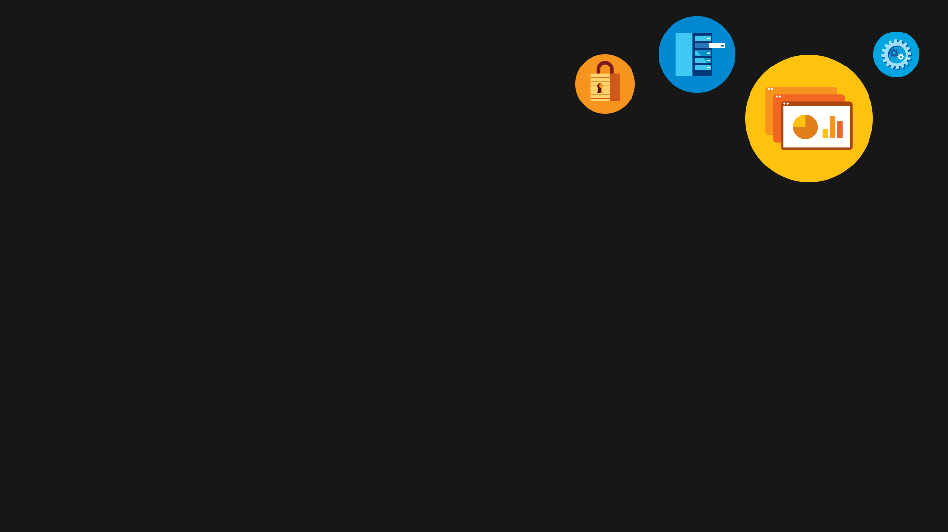
Questions?

